Slide 1
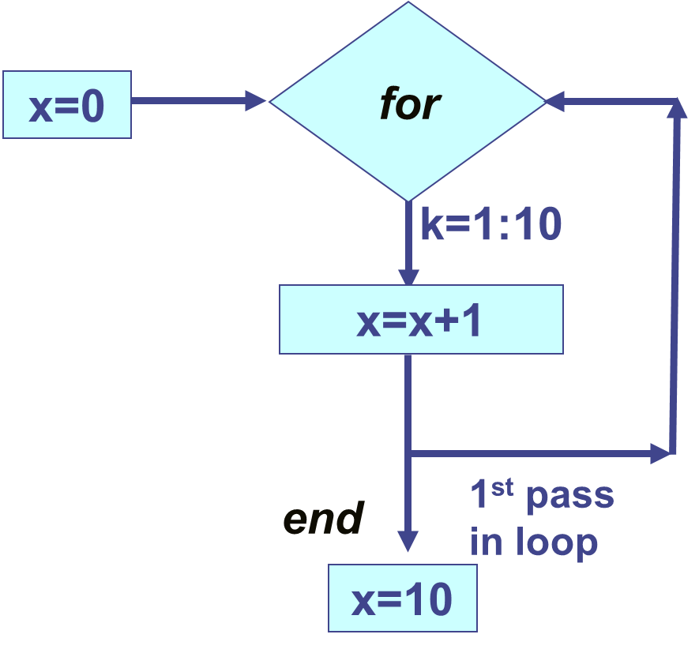

Loops – Part 1
for-end
Loops – Part 2
while-end
Loops – Part 3
Nested looping
Combinations of conditional expressions & loops
First Year Engineering Learning Center
College of Engineering
Northeastern University

Slide 2
Loops: for – end
Loops repeat commands or a group of commands.
Each repetition is called a “pass”.
At least one variable during each pass is assigned a new value.
% write a new script .m file
clear; clc; format compact
x=0; % initialize x (set it to 0)
for k=1:1:10 % k is a “looping” variable
x=x+1 % loop adds 1 to x each pass
end
vs
% try this too
>> clear; clc;
>> x=0:1:10

Slide 3
Loops & Element-by-Element Math
Some loops can also be alternatively completed using arrays and element-by-element math.
In some cases, the element-by-element approach may be more efficient and faster than using a loop to obtain the same result.
% write a new script .m file
clear; clc;
for k=1:4:10 % k is a “looping” variable
k % display current value of k
x=k^2 % complete calculation & display x
end
vs
% try this too
>> clear; clc;
>> k=1:4:10
>> x=k.^2

Slide 4
Example: Loop & Summation Series
Draw a flowchart to calculate the sum of the first n terms of the summation Σ1/i series:
i = i + 1
no
start
n = ?
sum = 0
i = 1
sum = sum + 1/i
i = n?
input
initialize
initialize
yes
sum
output
stop

Slide 5
Example: Loop & Summation Series
In a script .m-file:
%For Loop & 1/i Summation Series Solution by Professor Love
clc,clear %clear the Command Window and Workspace
n=input('Enter the number of terms desired in the summation series:')
sum = 0 %initialize the variable sum so that it has a starting value to add to
for i=1:n
sum=sum+1/i
end
fprintf('\n The sum of %-i terms is %-5.4f \n', n, sum)

Slide 6
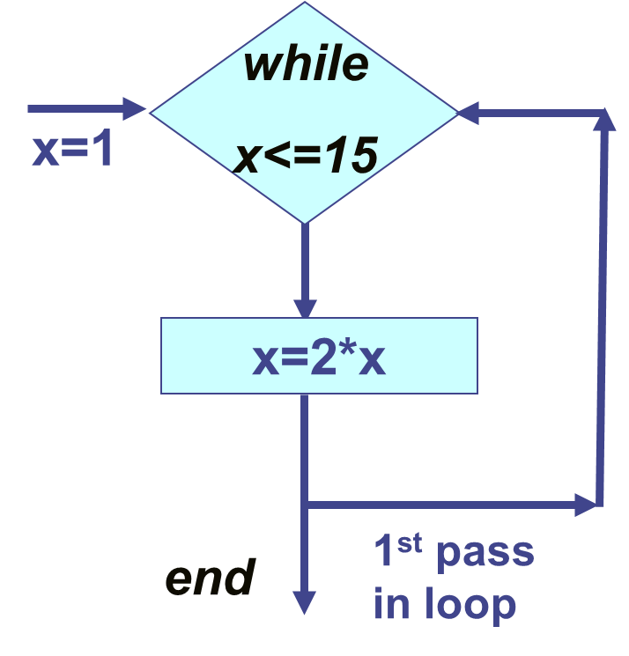
While loop

Slide 7
Loops: while-end
To break out of a never-ending loop, press CTRL+C or CTRL+Break
The number of passes is NOT known.
The while expression must first be true for the while loop to start.
Expression must be false to exit loop.
% write a new script .m file
clear; clc; format compact
x=1; % initialize x (set it to 1)
while x<=15 % conditional or logical exp
disp(‘****’), x % display stars and x
x=2*x
end
vs
% try this too
>> clear; clc;
>> x=2.^(0:4)

Slide 8
Example: while-end loop
To break out of a never-ending loop, press CTRL+C or CTRL+Break
Use a while loop to ensure particular outcomes in your program.
Remember that the while expression must be true to run.
% write a new script .m file that ensures x is between 5 - 10
clear, clc, format compact
x=0; % initialize x (set equal = 0 to demonstrate example)
while (x< 5 || x > 10) % conditional or logical expression
x=input(‘Enter a number between 5 & 10, including 5 or 10’)
end
fprintf(‘\n %i is between 5 & 10 so let us calculate y=x^2: \n’,x)
y=x^2

Slide 9
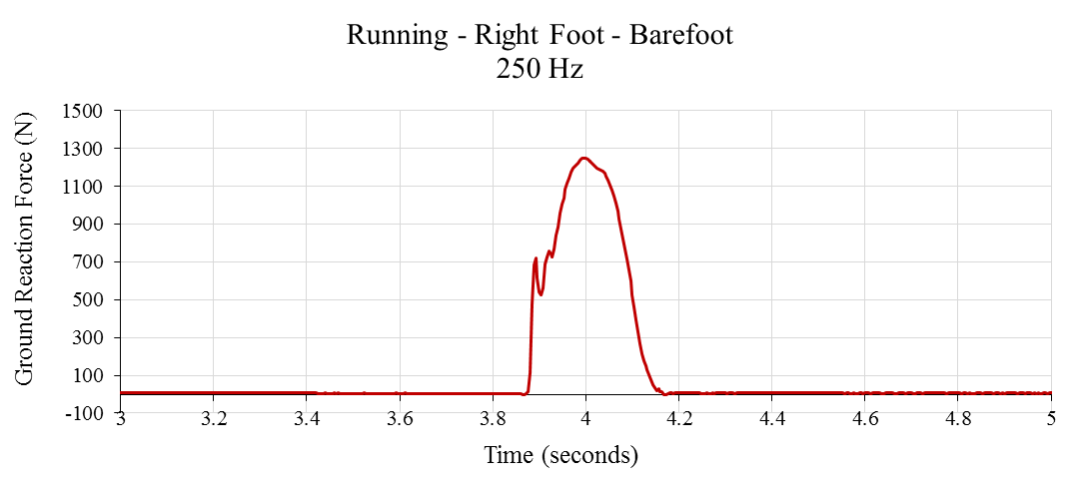
Example 1: Nested Loops with Conditions
Use loops to systematically evaluate arrays of data.
Use conditional statements and logic to help execute certain commands when certain conditions are met.
clear, clc, format compact %script file
force=[0 1 2 3 4.5 5 4.5 3 2 1 0]
time=[0 .05 .1 .2 .3 .4 .5 .6 .7 .75 .8]
max = 0 % initialize max=0
for k=1:11 % conditional expression
if force(k)>max
max=force(k);
end
end
vs
% try this too
>> clear; clc;
>> force=
[0 1 2 3
4.5 5 4.5
3 2 1 0]
>>MAX=max(force)

Slide 10
Example 2: Nested Loops with Conditions
clear; clc; format compact % create a new script file
V=[2 3 91 87 5 8] % initialize V array
Even=[ ] % create empty Even and Odd arrays
Odd=[ ]
while length(V)>0
if rem(V(1),2)==0 % use remainder to check odd or even
Even=[Even V(1)] % add even #’s to the Even array
else
Odd=[Odd V(1)] % add odd #’s to the Odd array
end
V(1)=[ ] %delete the 1st element of V
end

